Slide 1
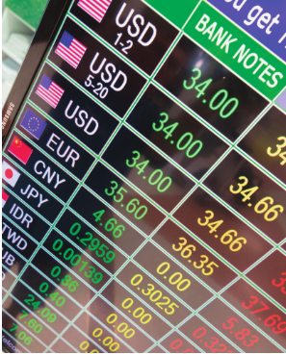
Chapter 20: International Finance
Wayne Geerling
University of Texas

Slide 2
Big Questions
Why do exchange rates rise and fall?
What is purchasing power parity?
What causes trade deficits?

Slide 3
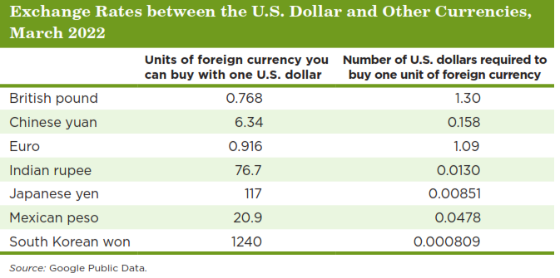
The nominal exchange rate: rate at which two currencies can be traded for each other.
Exchange rates can be expressed either as the amount of foreign currency needed to purchase one U.S. dollar or as the number of U.S. dollars needed to purchase one unit of the foreign currency.

Slide 4
Exchange Rate Movements
Appreciation: increase in the value of a currency relative to other currencies.
Depreciation: decrease in the value of a currency relative to other currencies.

Slide 5

Using Squid Game to Teach Exchange Rate Movements

Slide 6
Questions
The current jackpot is 25.5 billion SK ₩.
Current exchange rate: 1 USD = c. 1,300 SK ₩
1. If 1 USD is equal to 1,300 SK ₩, what is 25.5 billion SK ₩ equal to in USD?
Answer: 25.5 billion / 1,300 = USD $19,615,384.
2. If the USD appreciates against the SK ₩, the 25.5 billion SK ₩ jackpot is worth ____ in USD.
A. More
B. Less
C. Stays the same.

Slide 7
Questions
3. Assume 1 USD is now equal to 2,000 SK ₩. What is the 25.5 billion SK ₩ jackpot now worth in USD? What is the change from Q1?
Answer: 25.5 billion Wong/ 2,000 = USD $12,750,000; a decrease of $6,865,384

Slide 8
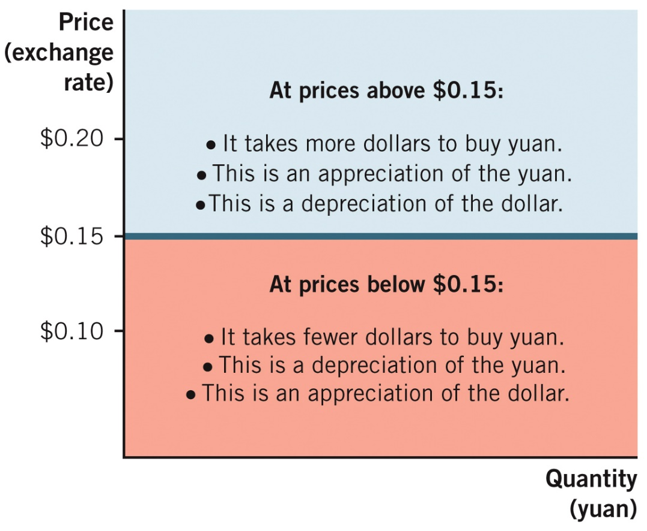
Appreciation & Depreciation Example

Slide 9
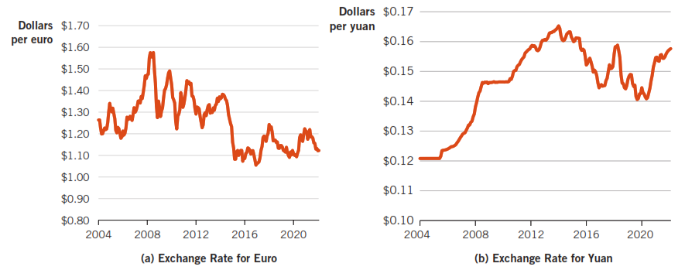
Exchange Rates: Historical Perspective, 2004-2021

Slide 10

Demand for Foreign Currency
Factors that affect the demand side of the market for foreign currency:
The exchange rate (price) of the currency (movement)
Demand for foreign goods & services (shift)
Demand for foreign financial assets (shift)

Slide 11

Demand for Foreign Goods & Services
The demand for foreign currencies is a derived demand.
When the demand for a nation’s exports rises, the demand for its currency rises, too.
Example: When the demand for Chinese goods rises, so does the demand for yuan.

Slide 12
Demand for Foreign Financial Assets
To buy foreign stocks or bonds, you need foreign currency.
If interest rates in a foreign country rise (relative to the rest of the world):
People will buy more financial assets in that country.
Demand for that country’s currency will increase.
Exchange rates & foreign interest rates are two different prices.
United States is seen as low risk & stable.
Foreigners demand U.S. dollars for this reason.

Slide 13
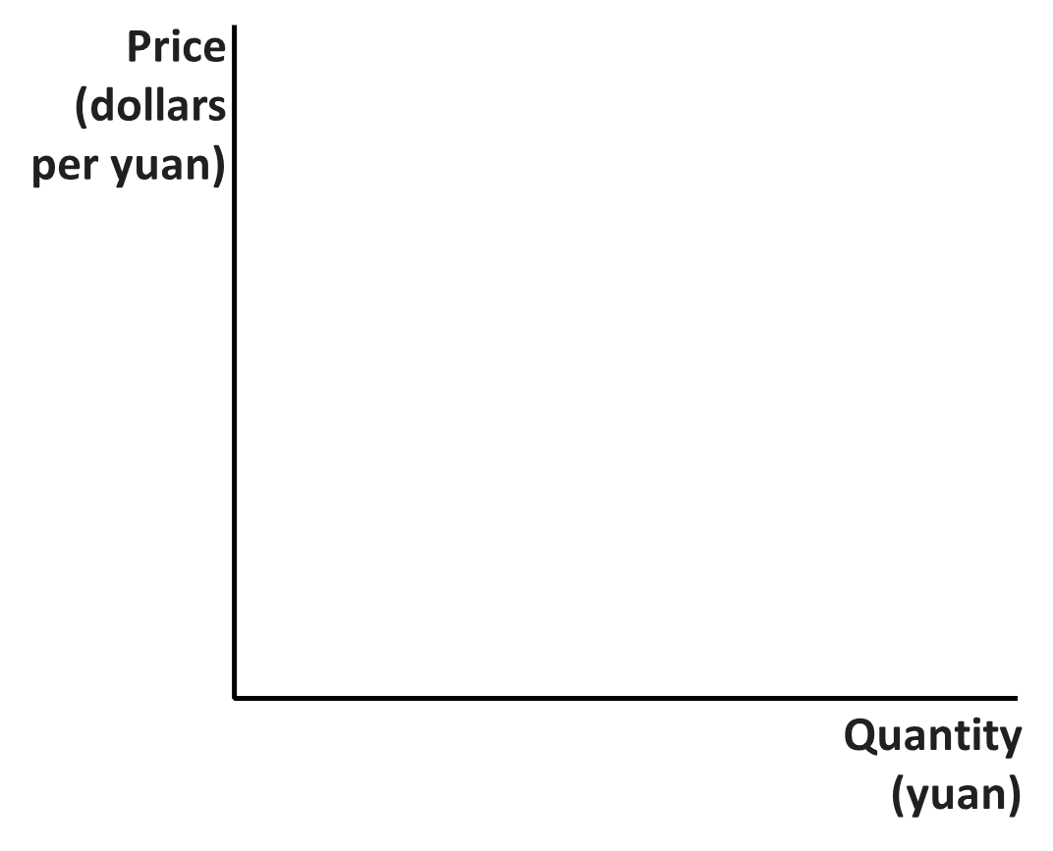
Shifts in Demand for Foreign Currency
$$D_{2}$$
$$D_{1}$$
$$D_{3}$$

Slide 14
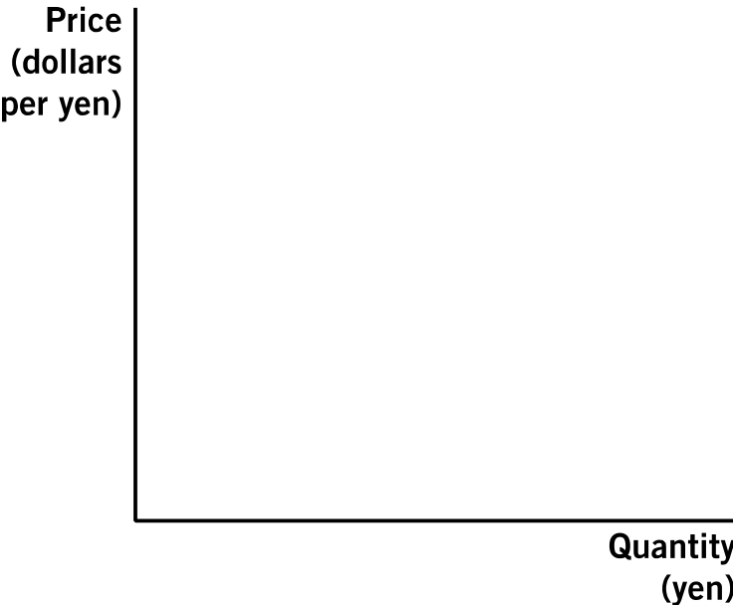
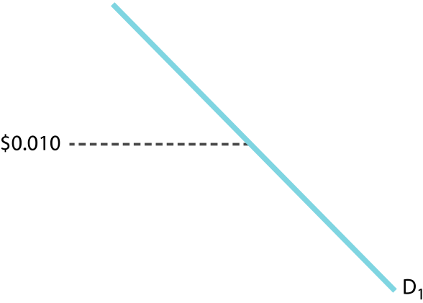
How Demand Shifts Affect the ER
Price
(dollars per yuan)
$0.15
Quantity
(yuan)

Slide 15
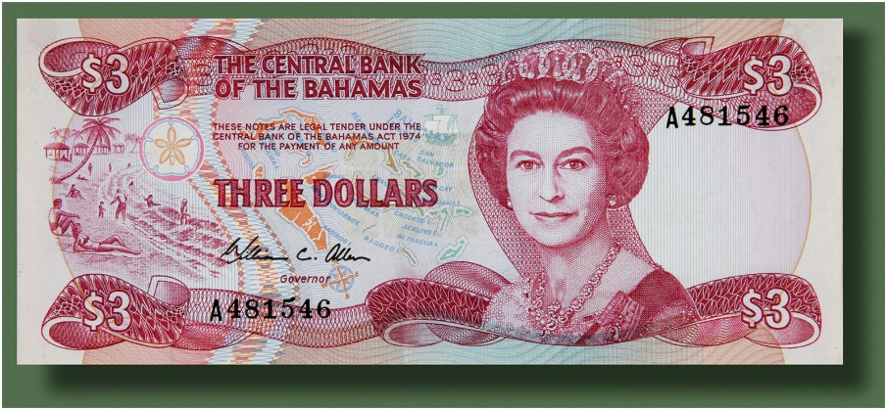
Supply of Foreign Currency
The government controls the money supply.
From a market standpoint, there is a fixed amount of fiat currency at any one time.
Vertical supply curve.
Curve can shift with increases or decreases in the money supply.

Slide 16
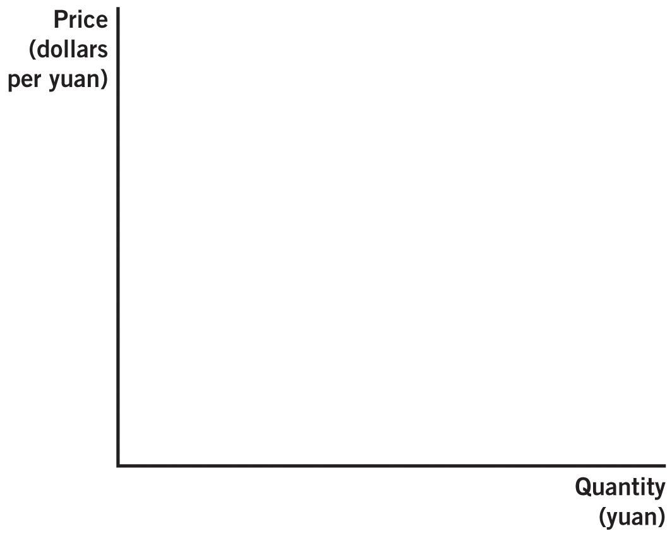
Shifts in the Supply of Foreign Currency

Slide 17
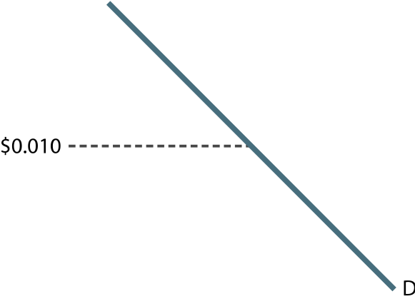
How Supply Shifts Affect the ER
$0.15
Quantity
(yuan)

Slide 18
Changes in Supply
Exchange rate manipulation: When a national government intentionally adjusts its money supply to affect the exchange rate of its currency.
Why devalue your own currency?
Lowering the exchange rates makes your exports more attractive & affordable.
Boosts production by shifting AD to the right through increased exports.
No long-term shift in LRAS, just higher inflation.

Slide 19
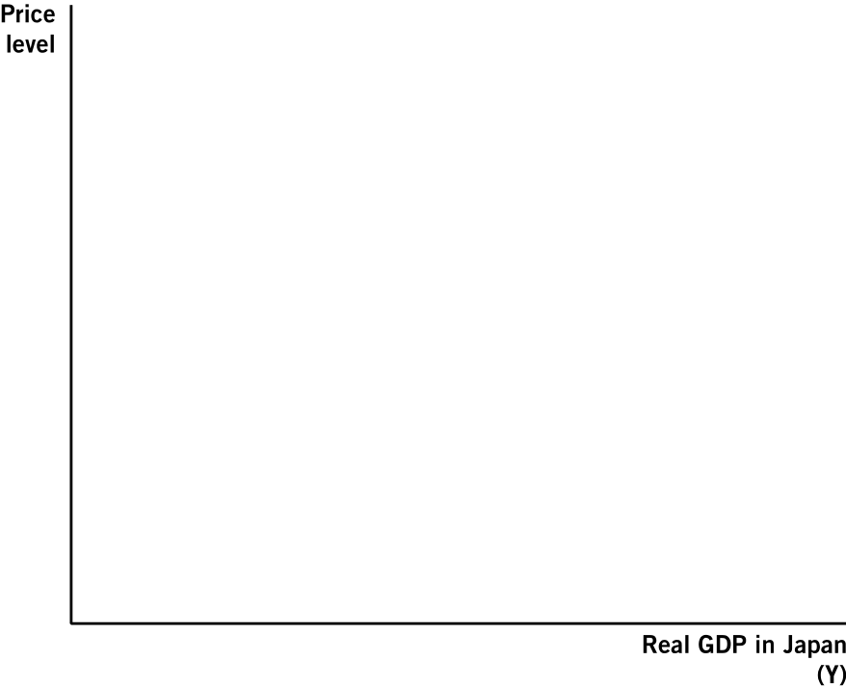
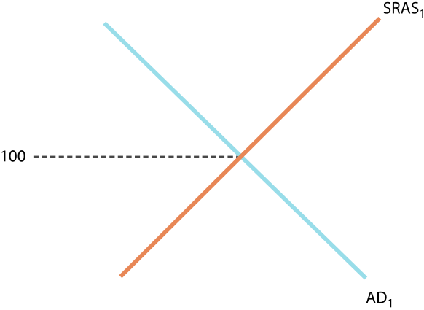
Increase in China’s AD from Yuan Depreciation
Real GDP in China
(Y)

Slide 20
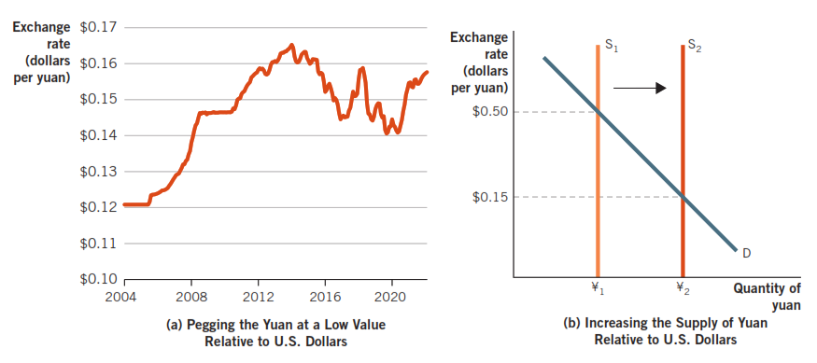
Example: How China Pegs the Yuan
The Chinese government maintained its peg by adjusting the supply of yuan made available to world markets in order to keep the yuan below market rates.

Slide 21
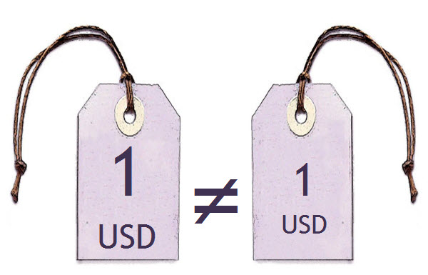
Purchasing Power Parity (PPP)
Law of one price states that if transportation costs are relatively small, the price of an internationally traded commodity must be the same in all locations.

Slide 22
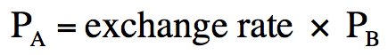
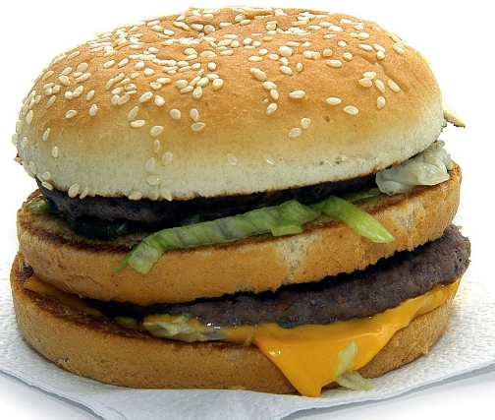
Purchasing Power Parity & Exchange Rates
For any good at locations A & B, purchasing power parity will hold if:
Worldwide PPP would hold if the equation is true for any two countries.

Slide 23
Why PPP Does Not Hold Perfectly
Reasons why PPP may not hold in the short run:
1. Goods and services must be identical: Brand names may mean different things in different countries
2. Some services are not tradable: You can’t import or export haircuts or tattoos
3. Trade barriers (quotas, tariffs & regulations) may inhibit trade
4. Shipping costs
5. Some prices take longer to adjust

Slide 24
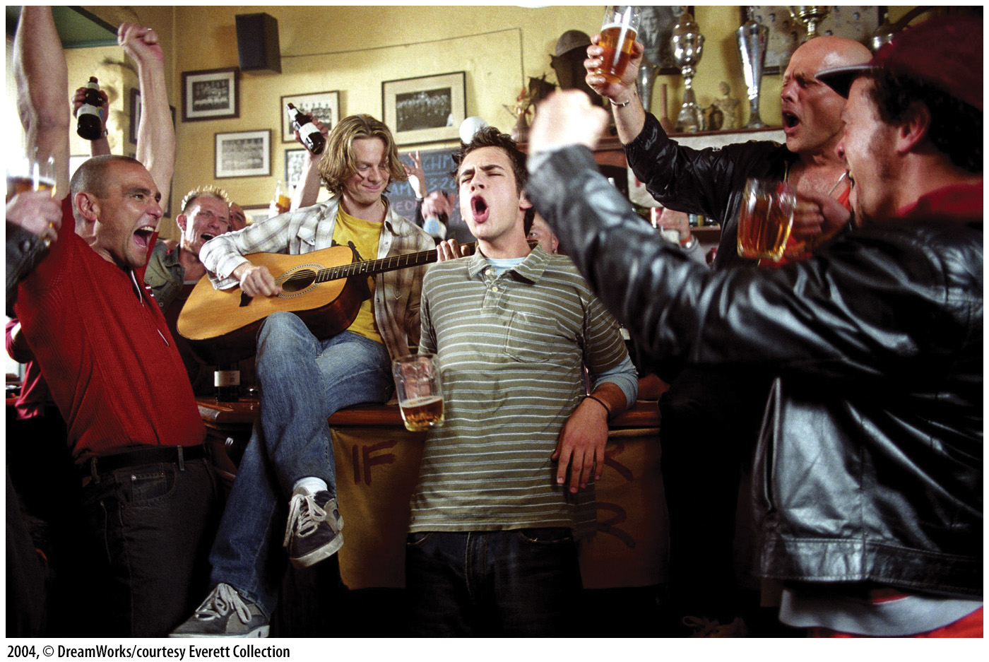
Economics in EuroTrip
In this scene, four college-age friends get stranded in an eastern European country.
Thankfully, PPP does not hold.
Obviously, the scene is exaggerated…

Slide 25
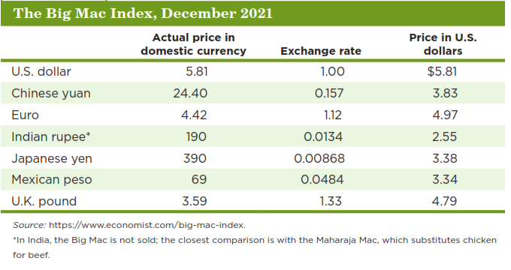
The Big Mac Index
If PPP held perfectly, the prices in the last column would all be $5.81, the price of the Big Mac in the U.S.

Slide 26

The Law of One Price: What Should the Price Be?
The Ikea furniture company sells Swedish bookshelves all over the world.
The base price for the BILLY bookcase is $59.99 in the U.S. & ₤35 in the UK.
The exchange rate is 1₤ = $1.50.
A) What is the implied PPP price for the bookcase in the UK?
$59.99 = $1.50 x price in the United Kingdom
$$\frac{59.99}{1.50}=39.99$$

Slide 27
The Law of One Price: What Should the Price Be?
B) The price implied by PPP was ₤39.99 but the actual price in the UK at the time was ₤35. What are some possible reasons why the price in the UK was lower than in the US?
Lower shipping costs to the UK.
Lower barriers across Europe than between Europe and the United States

Slide 28
Balance of Payments (BOP)
Record of payments between a country & the rest of the world.
A method to track payments made across borders.
Current account: Account that tracks all payments for goods & services, current income from investments, and gifts.
Often in a deficit (inflows > outflows).
Capital account: Account that tracks payments for real & financial assets between nations and extensions of international loans.
Often in a surplus (outflows > inflows).

Slide 29
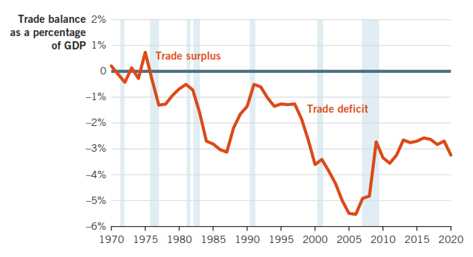
U.S. Trade Balance and Recessions, 1970–2020

Slide 30
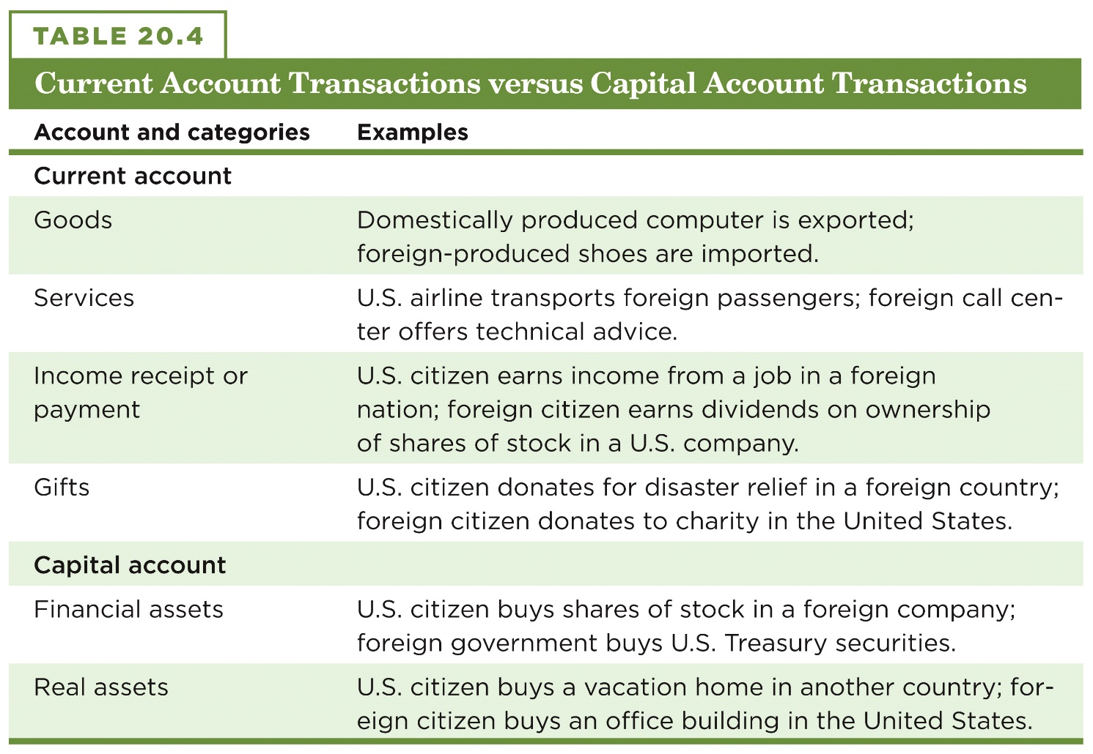
Current Account & Capital Account Transactions

Slide 31
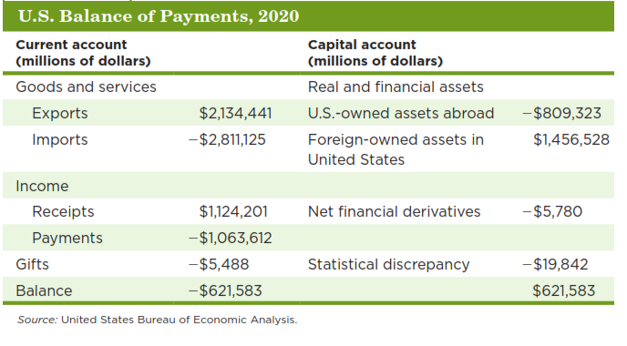
U.S. Balance of Payments (Millions of Dollars)

Slide 32
The Key Identity of Balance of Payments
While either account can be in deficit or surplus, together they sum to zero.
A positive balance in the current account means there must be a negative balance in the capital account, and vice versa.
$$Currentaccountbalance+capitalaccountbalance= 0$$

Slide 33
Balance of Payments Example
Assume trade deficit begins at zero:
$Imports=exports$.
Capital account is balanced too:
$U.S.ownershipofforeignassets=foreignownershipofU.S.assets$.
Now, suppose you buy a $40,000 Japanese car:
Imports exceed exports by $40,000
Current account deficit of this amount.
You exchanged $40,000 (U.S. financial asset) for the car.
Capital account surplus of $40,000

Slide 34
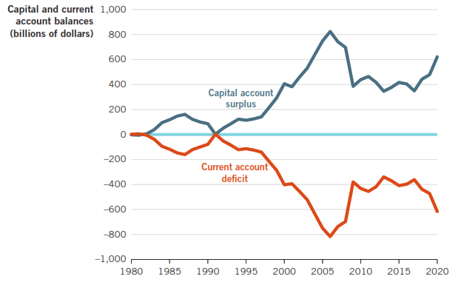
U.S. Current & Capital Account Balances

Slide 35

What Causes Trade Deficits?
Trade deficit: A current account deficit.
Or a capital account surplus
Three primary causes of current account deficits:
1. Strong economic growth
2. Lower personal savings rates
3. Fiscal policy

Slide 36

Causes of Trade Deficits: Strong Economic Growth
Current account deficits
Wealthy consumers can afford more imports
Imports increase at a faster rate than exports
→ current account deficit appears
Capital account surplus
Growing economies offer higher returns on investment
Demand for loanable funds increases
Funds flow in from around the world
→ capital account surplus

Slide 37

Causes of Trade Deficits: Lower Personal Saving
When individuals & governments save, this saving can be used for investment
If domestic savings falls, investment must be funded with outside sources.
This financing comes from savers in foreign countries.
Bringing this investment into the United States increases the capital account surplus.

Slide 38
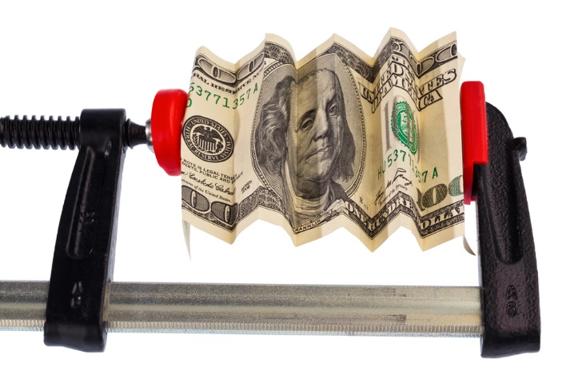
Causes of Trade Deficits: Fiscal Policy
Budget deficits also contribute to current account deficits.
These deficits consume domestic funds.
The government is using funds that could have been used for private investment (crowding out).
International funds also fund the deficit, which increases the capital account surplus.

